Slide 1
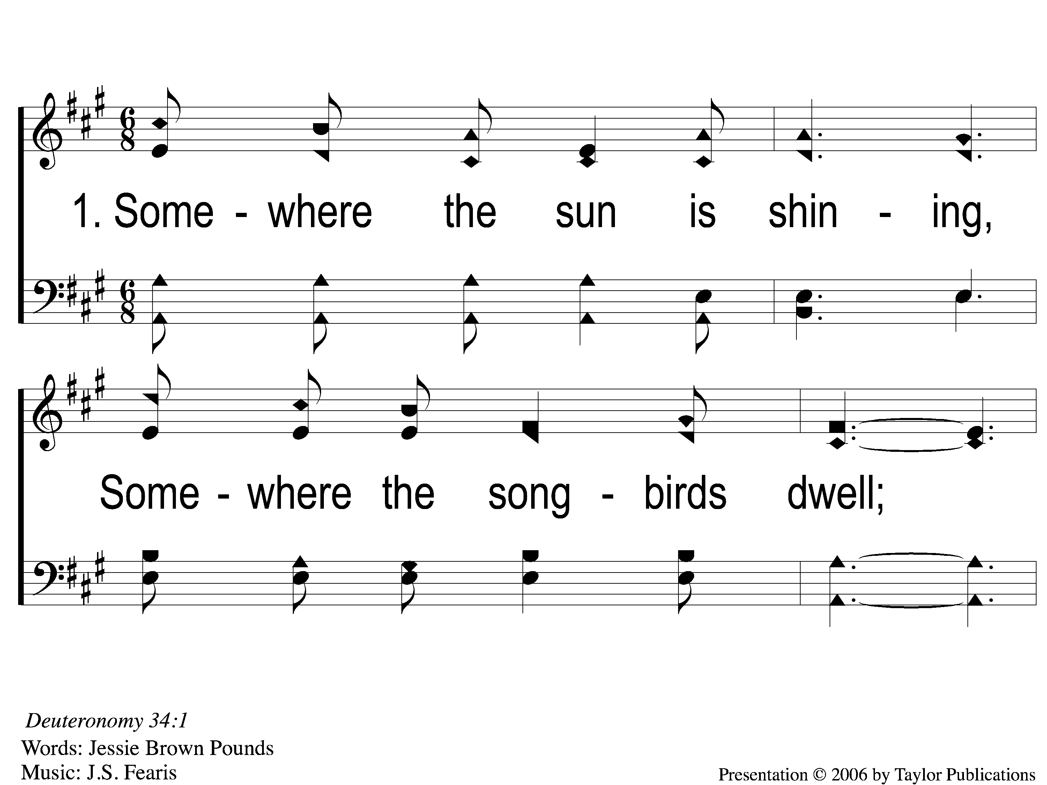
1-1 Beautiful Isle of Somewhere
Beautiful Isle of Somewhere
37

Slide 2
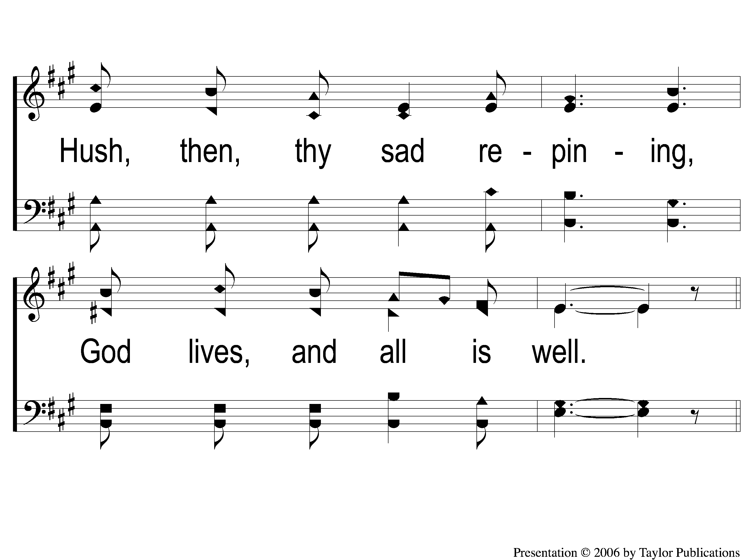
1-2 Beautiful Isle of Somewhere
Beautiful Isle of Somewhere
37

Slide 3
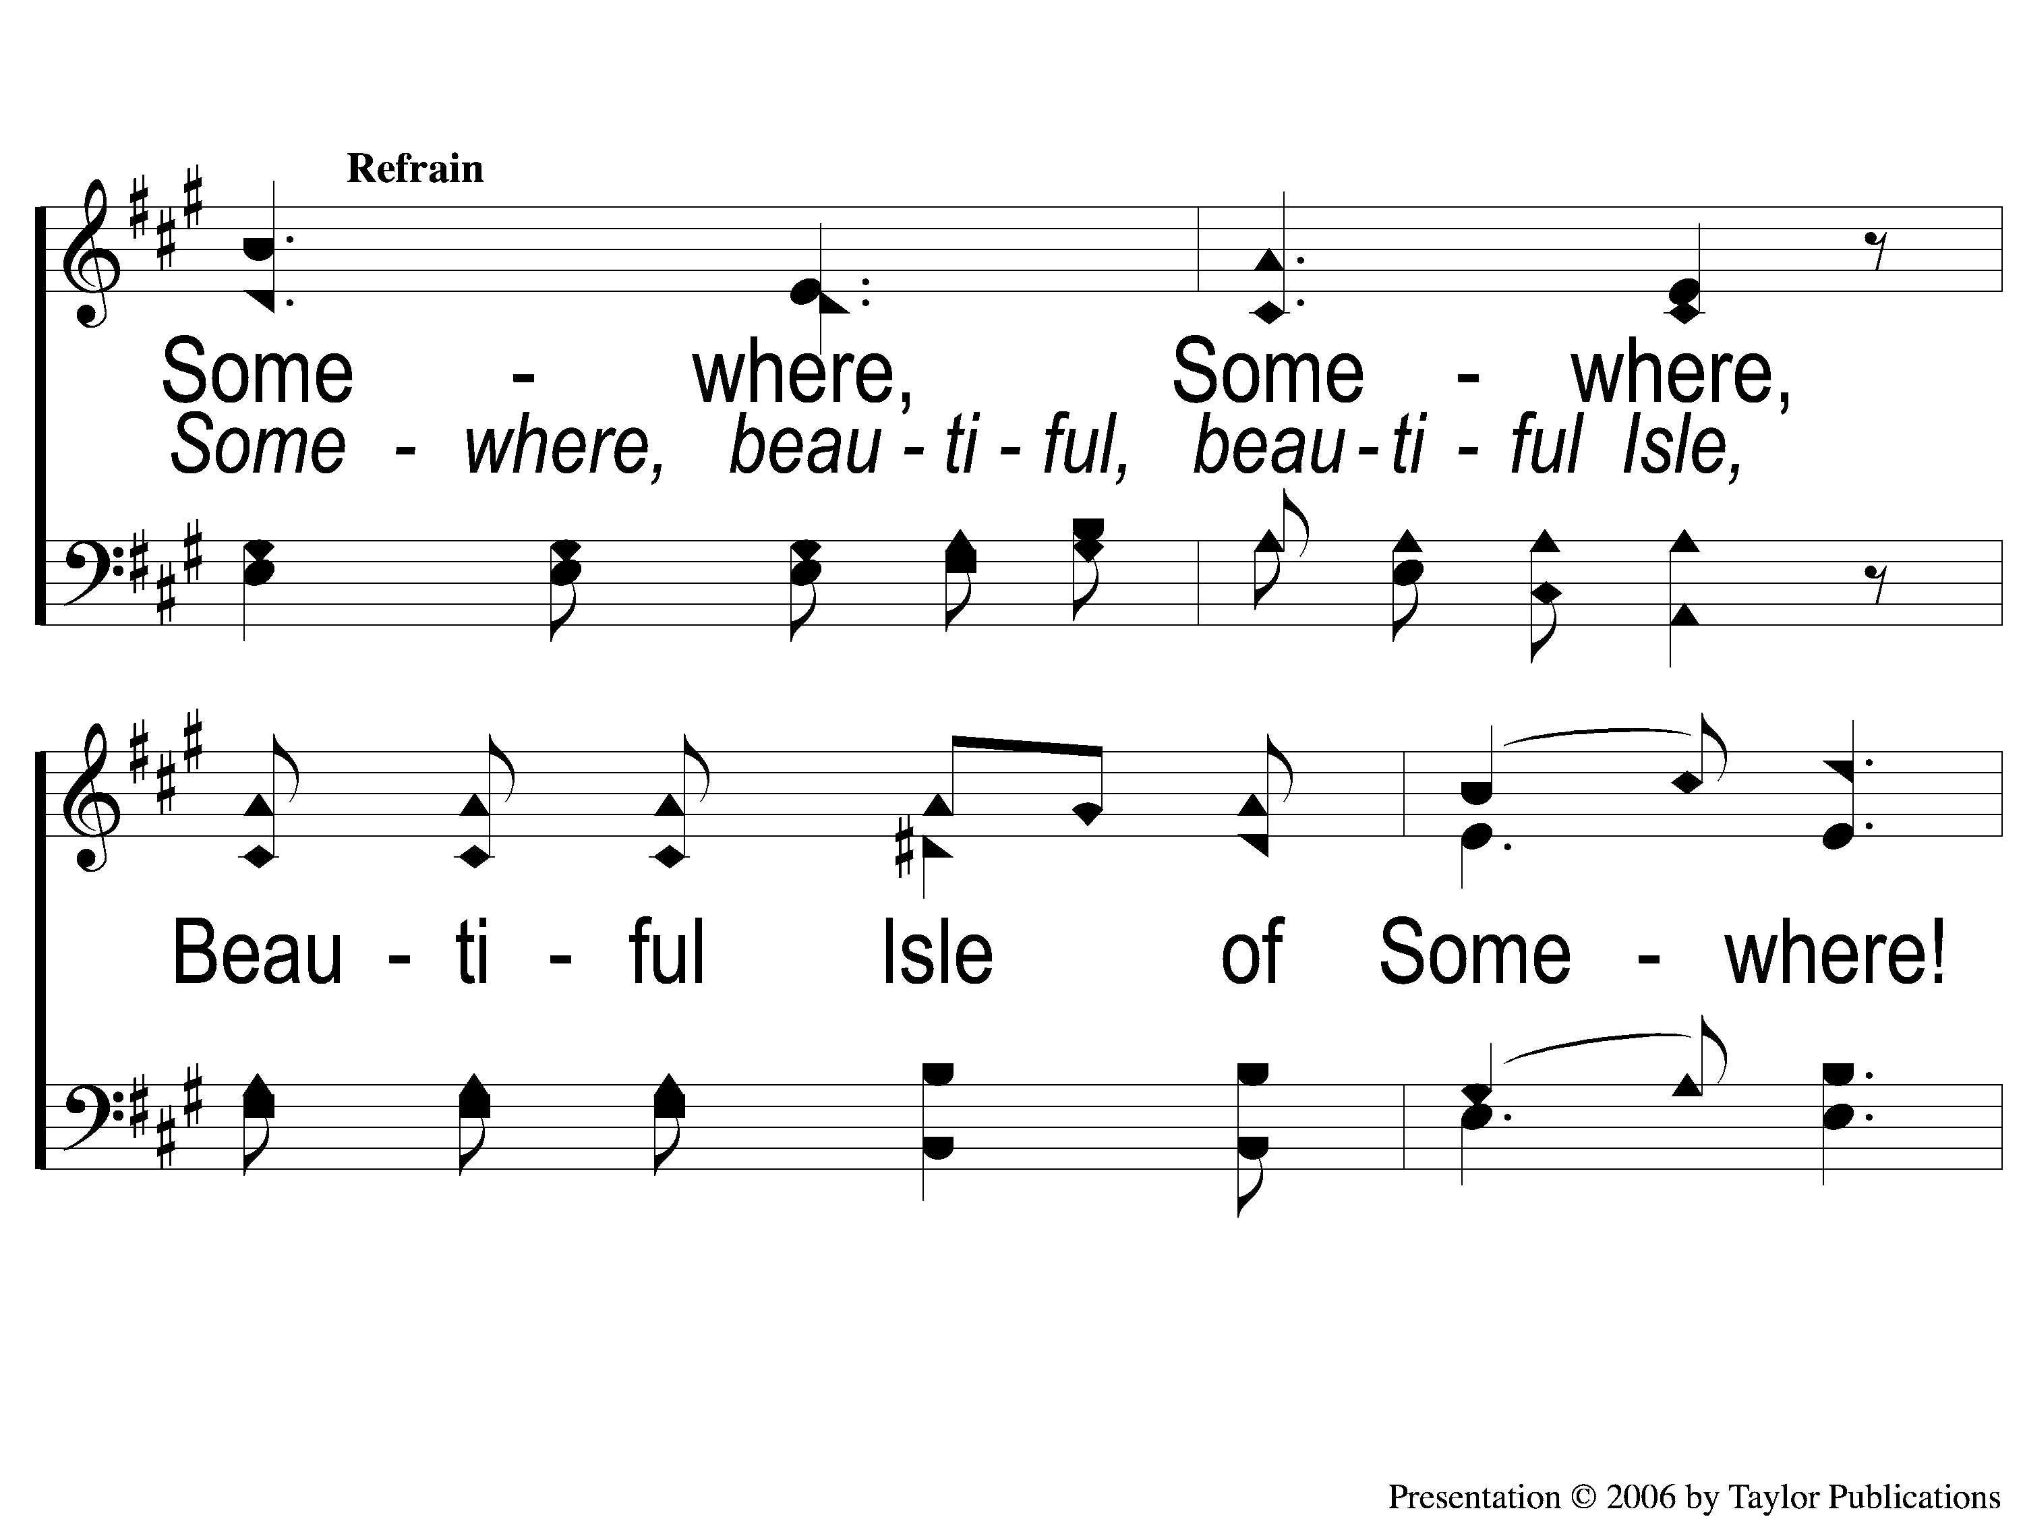
C-1 Beautiful Isle of Somewhere
Beautiful Isle of Somewhere
37

Slide 4
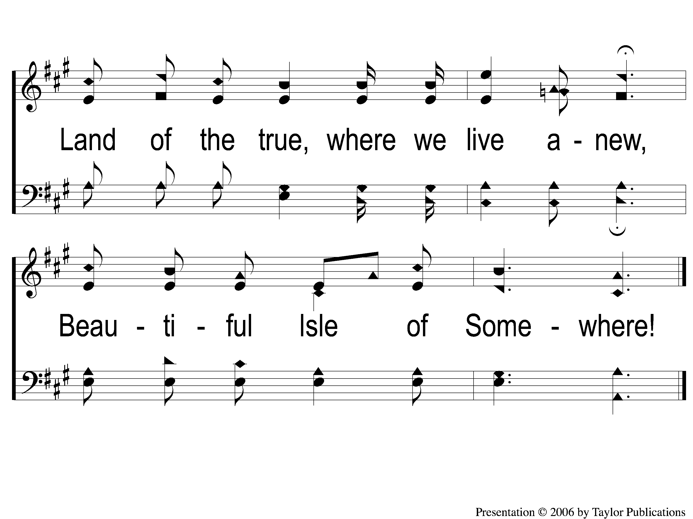
C-2 Beautiful Isle of Somewhere
Beautiful Isle of Somewhere
37

Slide 5
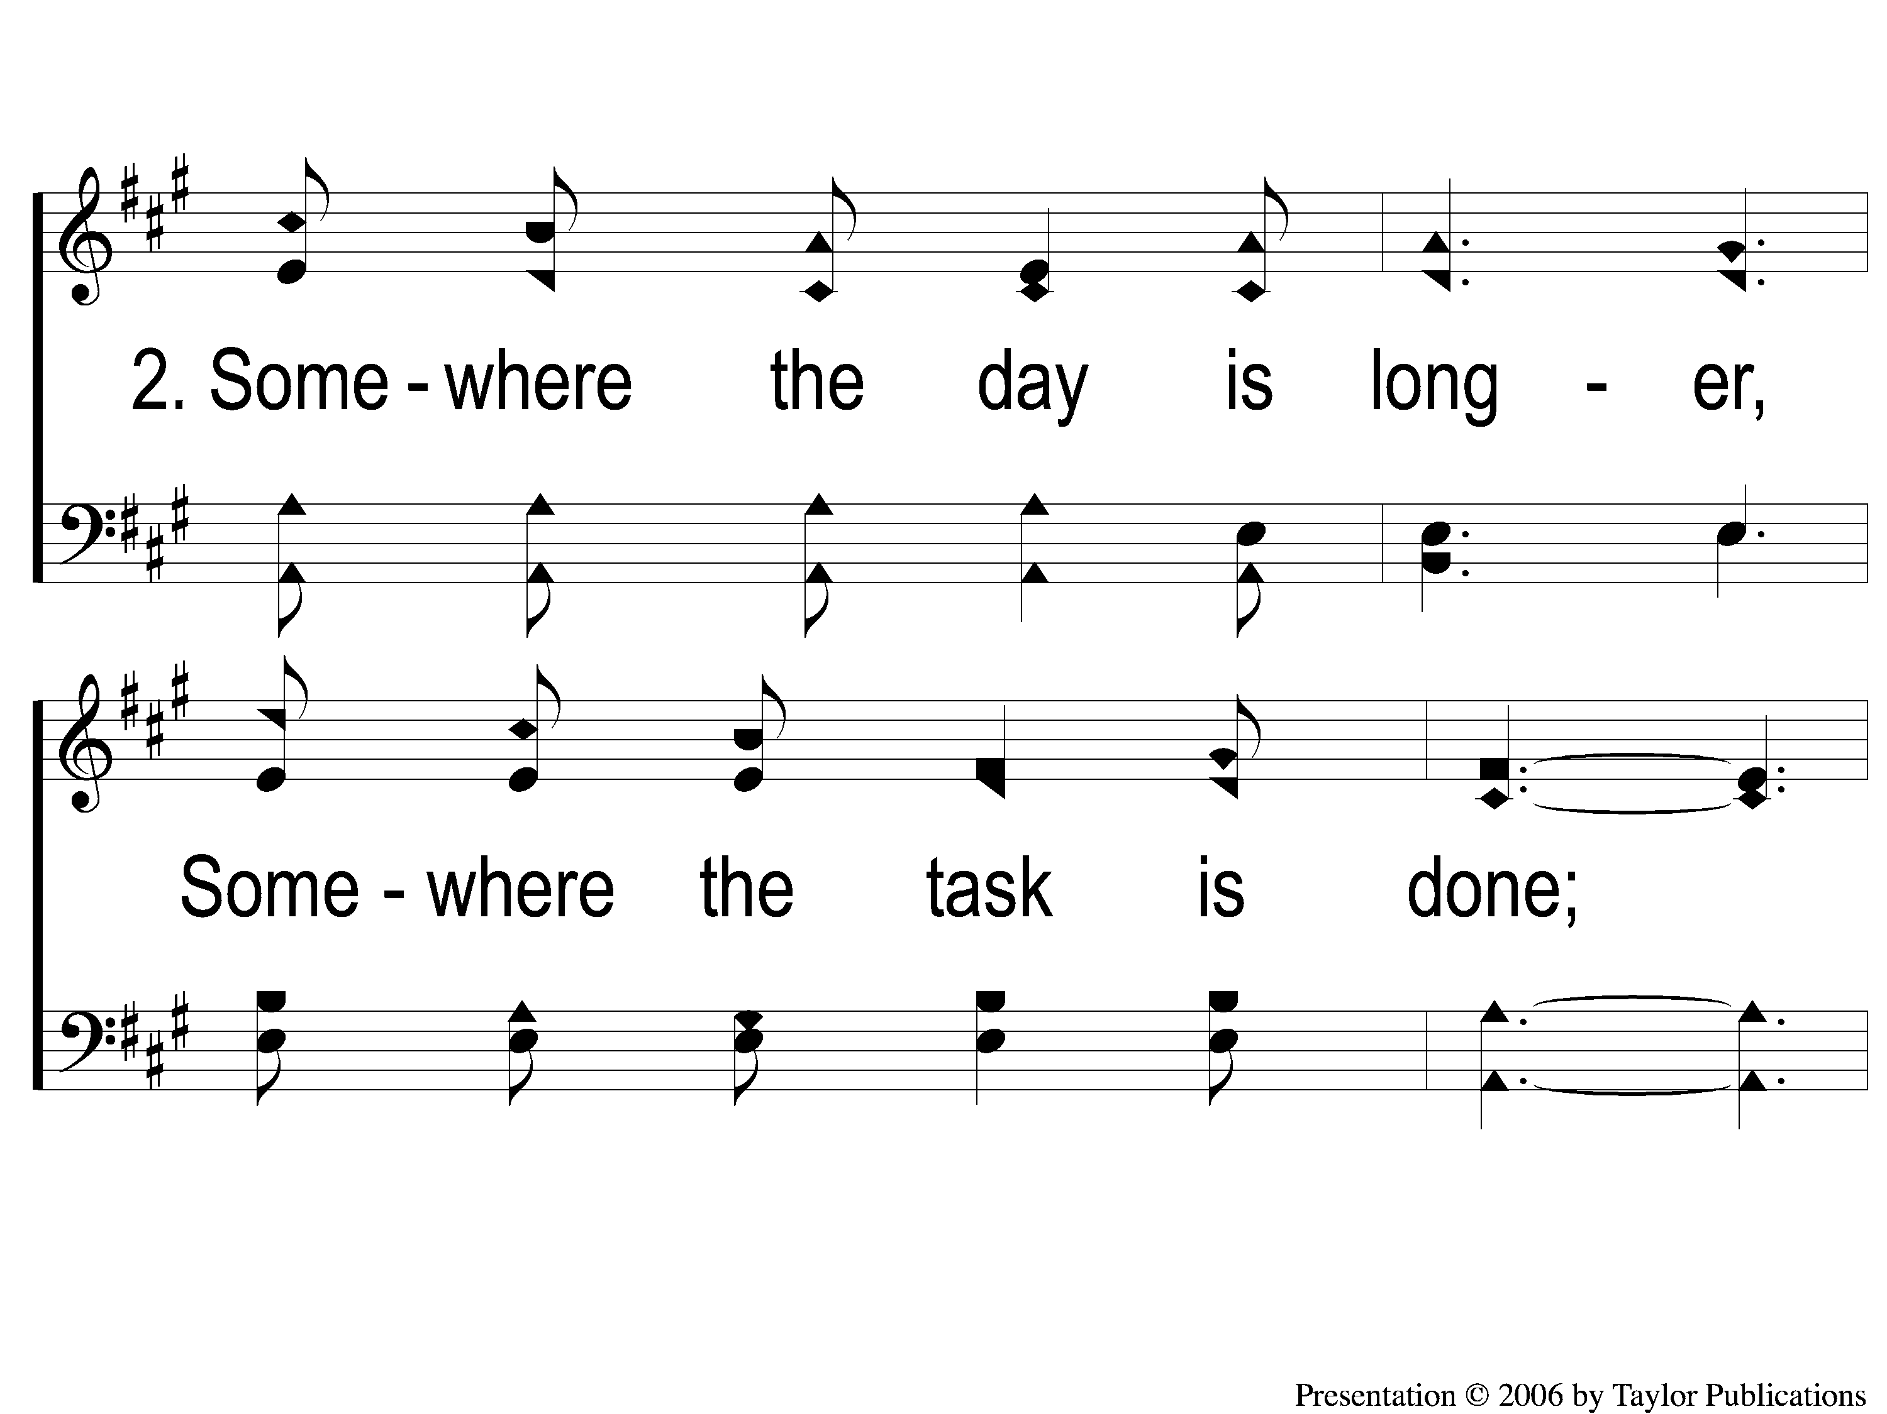
2-1 Beautiful Isle of Somewhere
Beautiful Isle of Somewhere
37

Slide 6
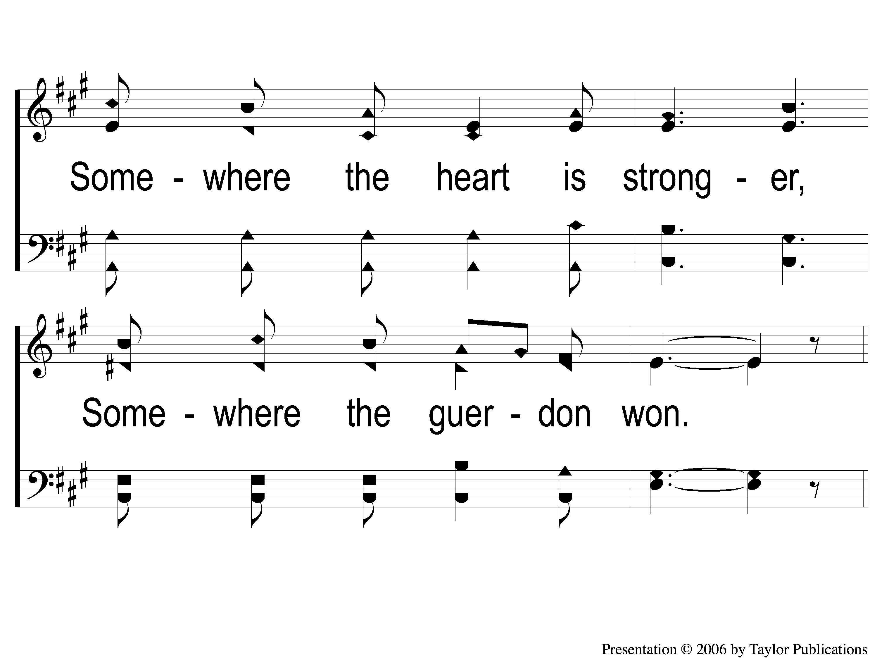
2-2 Beautiful Isle of Somewhere
Beautiful Isle of Somewhere
37

Slide 7
C-1 Beautiful Isle of Somewhere
Beautiful Isle of Somewhere
37

Slide 8
C-2 Beautiful Isle of Somewhere
Beautiful Isle of Somewhere
37

Slide 9
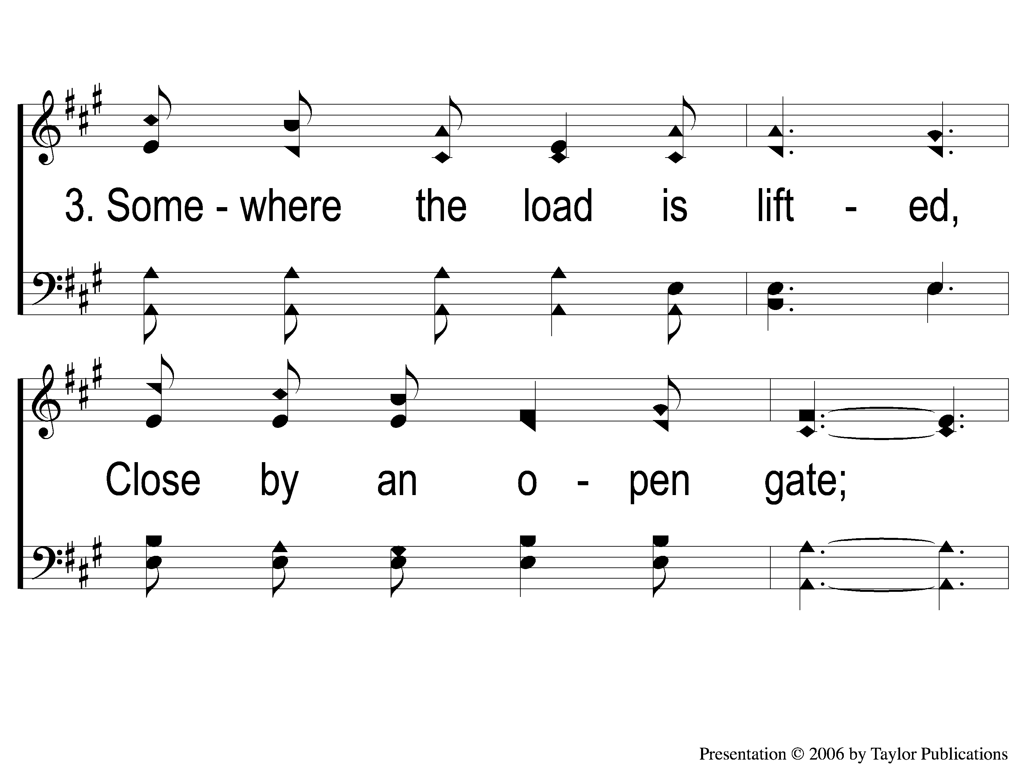
3-1 Beautiful Isle of Somewhere
Beautiful Isle of Somewhere
37

Slide 10
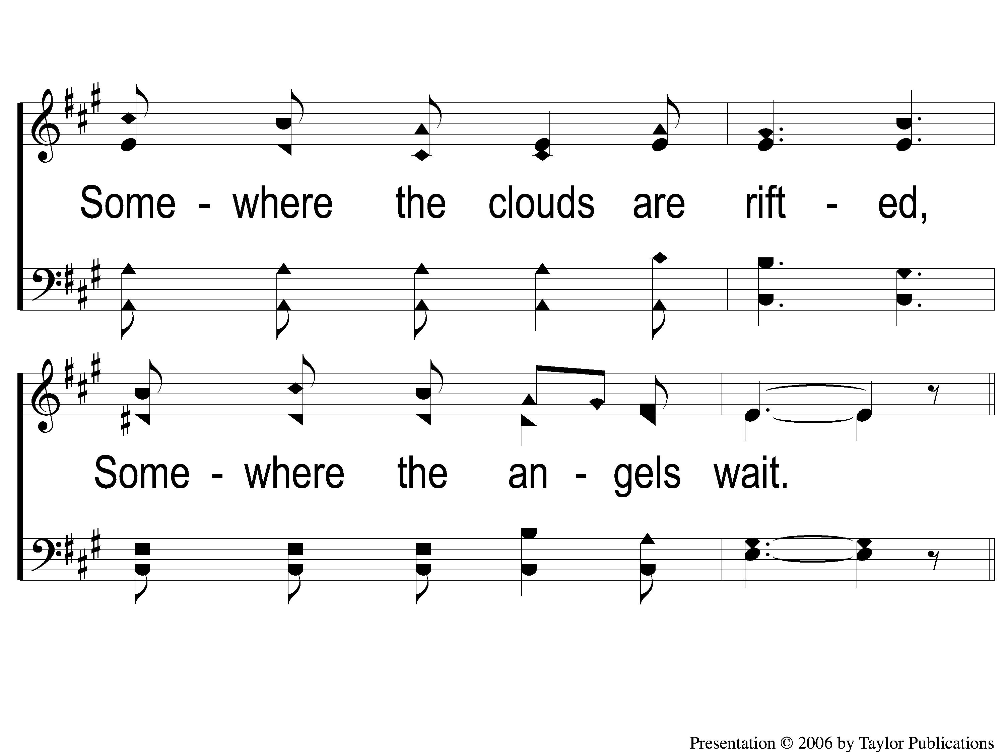
3-2 Beautiful Isle of Somewhere
Beautiful Isle of Somewhere
37

Slide 11
C-1 Beautiful Isle of Somewhere
Beautiful Isle of Somewhere
37

Slide 12
C-2 Beautiful Isle of Somewhere
Beautiful Isle of Somewhere
37

